Slide 1
Econ 100 Principles of Economics
Lecture 14
April 12

Slide 2
Today’s plan:
Market efficiency: the argument for market economies
A few real-life examples
5th assignment on Friday, 30 questions and 90 minutes

Slide 3
Efficiency and welfare

Slide 4
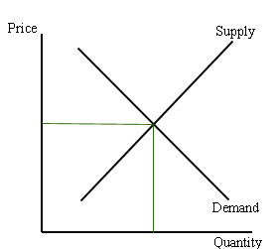
The equilibrium in the competitive market
Equilibrium means
Demand = Supply

Slide 5
Question about the competitive market equilibrium
Do the equilibrium price and quantity maximize the total welfare of buyers and sellers?

Slide 6
We will look for the answers to these questions
What is consumer surplus?
How is it related to the demand curve?
What is producer surplus?
How is it related to the supply curve?
Do markets produce a desirable allocation of resources?

Slide 7
Welfare Economics
Buyers and sellers receive benefits from taking part in the market.
Welfare economics is the study of how the allocation of resources affects economic well-being.
The equilibrium in a perfectly competitive market maximizes the total welfare of buyers and sellers.
The allocation of resources refers to
How much of each good is produced
Which producers produce it
Which consumers consume it

Slide 8
The equilibrium in the competitive market
Today we will show that
at the competitive equilibrium the total welfare of the consumers and the producers is maximized.
the welfare of the producers can be measured by the producers’ surplus, PS, where PS ≈ profits = total revenue – cost.
the welfare of the consumers can be measured by the consumers’ surplus, CS, where CS = Willingness to pay – price.

Slide 9
Consumer surplus
First, a definition
Willingness to Pay (WtP): the maximum amount a buyer will pay for a good.
Economist believe that WtP is a good measure of how much the buyer values the good or service.
Example:
If I am willing to pay $10 (but not more) for one unit of some good X, this can reasonably (must) mean that
the benefit/value/satisfaction I (think) I am getting from consuming this one unit of good X equals $10.
Consumer surplus is the buyer’s WtP for a good minus the amount the buyer actually pays for it.
Example continued:
If my WtP is $10 and I actually pay only $7, my consumer surplus is
$10 – $7 = $3.

Slide 10
Funny things happen with the WtP!
Researchers find that “red color increases Willingness-to-pay”.
In an experimental study where subjects are asked to imagine that they are purchasing a Wii video game on eBay, it is found that when the “banner” color is red, people on average pay (about 6-7%) more than when it is gray or white.
“The effect of red background color on WtP” by Rajesh Bagghi and Amar Cheema, Journal of Consumer Research February 2013, pages 947-960.

Slide 11

The willingness to pay may not always show who values a good most highly!
Michael Sandel

Slide 12

Counterexample: Tickets to sporting events

Slide 13

Tickets to sporting events
Those who pay the most for tickets may not value the experience very highly at all. . .
The people sitting in the expensive seats at the stadium often show up late and leave early.
Do they really care about
the game?

Slide 14
Tickets to sporting events
Their ability to afford the best seats has more to do with the depth of their pockets than their passion for the game. . . .
This casts doubt on the claim that the price mechanism is the best way of getting goods to those who value them most highly.

Slide 15
Anyways, let’s consider a simple set-up

Slide 16
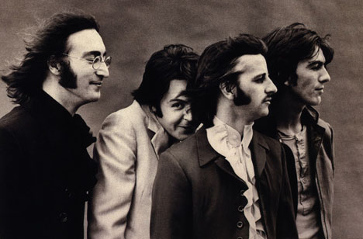
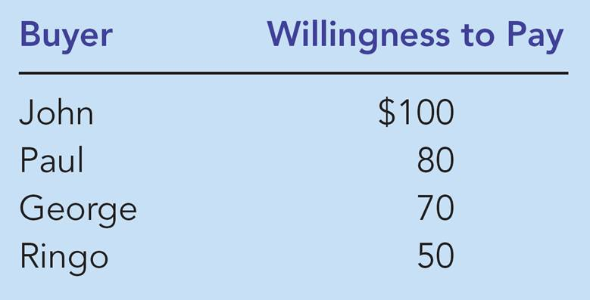
Four buyers; willingness to pay for a haircut

Slide 17
Four buyers; willingness to pay for a haircut
John, Paul, and George
John’s consumer surplus is
$100 – $60 = $40
Paul’s consumer surplus is
$80 – $60 = $20
George’s consumer surplus is
$70 – $60 = $10
Total consumer surplus is
$40 + $20 + $10 = $70
This is the total welfare of the consumers when the market price of haircut is P = $60.
Suppose that the market price is P = $60.
Who will buy?

Slide 18
Four buyers; allocating a limited supply of haircuts
Suppose we use the price mechanism to allocate the available amount of haircuts.
Which of the four consumers gets a haircut?
John and Paul.
The price mechanism allocates the limited supply of goods to consumers who are willing to pay the most for the goods.
Suppose that the supply of haircuts is limited: only 2 haircuts can be provided.
What is the lowest price at which quantity demanded equals 2?
It is $70⁺

Slide 19
Price mechanism: A necessary evil?
Allocating the limited supply of goods to consumers who are willing to pay the most for the goods is an attractive result when individuals have similar incomes.
It may be a disadvantage if richer persons get more haircuts or other goods than less rich people.
However, the best way to solve this problem is not by eliminating money prices as a way of allocating a limited supply, but instead by redistributing income to poorer individuals, and sometimes by directly subsidizing the consumption of goods by the poor.

Slide 20
5 buyers in the market for haircuts
Buyers’ WtP (=value of a haircut to buyers)
Peter $20
Paul $15
Mary $10
Jack $5
Jill $5

Slide 21
5 producers in the market for haircuts
Cost of haircut to sellers:
Firm V $5
Firm W $5
Firm X $10
Firm Y $15
Firm Z $20

Slide 22
Producers and their costs are as follows (no firm can produce more than one haircut)
Firm | Cost
V | $5
W | $5
X | $10
Y | $15
Z | $20
Suppose we use the price mechanism to decide which firm will do the production.
Which of the five firms will sell a haircut?
Firm V and W.
The price mechanism (competition) allocates the limited demand of goods to firms that have the lowest costs.
Suppose that only 2 haircuts are needed.
What is the highest price at which quantity supplied equals 2?
It is $10‒

Slide 23
Market for haircuts: demand and supply
WtP of buyers:
Peter $20
Paul $15
Mary $10
Jack $5
Jill $5
Cost of haircut to sellers:
Firm V $5
Firm W $5
Firm X $10
Firm Y $15
Firm Z $20
Price
Peter
Z
20
Paul
Y
15
Mary
10
X
Jack and Jill
5
V and W
0 1 2 3 4 5
haircuts

Slide 24
The equilibrium in the market for haircuts
Equilibrium Price = $10
Peter, Paul and Mary buy a haircut,
Firms V, W and X supply one haircut each.
Gains:
Peter = $20 - $10 = $10
Paul = $15 - $10 = $5
Mary = $10 - $10 = $0
V = $10 - $5 = $5
W = $10 - $5 = $5
X = $10 - $10 = $0
Total Gain: $25
Price
Consumer Surplus
Peter
Z
20
Paul
Y
15
Mary
10
X
Jack and Jill
5
V and W
0 1 2 3 4 5
haircuts
Producer Surplus

Slide 25
We use the demand curve to measure consumers’ surplus
The area below the demand curve and above the price line
measures the consumers’ surplus in the market.
Consumers’ surplus is the measure of consumers’ welfare.
The bigger this area, the larger the welfare of the consumers.

Slide 26
Consumers’ surplus: the area under the demand curve above the price line
Price
A
Initial
consumer
surplus
P₁
C
Consumer surplus
B
to new consumers
P₂
F
D
E
Additional consumer
Demand
surplus to initial
consumers
0
Q₁
Q₂
Quantity

Slide 27
We use the supply curve to measure producers’ surplus
The area above the supply curve and below the price line
measures the producers’ surplus in the market.
Producers’ surplus is the measure of producers’ welfare.
The bigger this area, the larger the welfare of the producers.

Slide 28
How the price increase affects producers’ surplus
Price
Additional producer
Supply
surplus to initial
producers
D
E
P₂
F
P₁
B
Initial
C
Producer surplus
producer
to new producers
surplus
A
0
Q₁
Q₂
Quantity

Slide 29
Consumers’ and producers’ surplus in the competitive equilibrium
Price
A
D
Supply
Consumer
surplus
Equilibrium
E
price
Producer
surplus
Demand
B
C
0
Equilibrium
Quantity
quantity
Copyright©2010 South-Western

Slide 30
All scarce goods must be rationed
That means some consumers will go without.
There are also other ways to ration/allocate:
Beauty
Seniority
“Fist come, first served”
Lottery
Equal shares for all
“Might makes right”
Merit

Slide 31
First come first serve: Another example
Linestanding.com

Slide 32
First come first serve: Another example
Linestanding.com
“… meant frustration for some environmentalists. When a group of them showed up for the congressional hearing on climate change, they couldn’t get in. The lobbyists’ paid stand-ins had already staked out all the available seats in the hearing room.”
(From “What Money Can’t Buy: Moral Limits of Markets” by Michael Sandel.)

Slide 33
A difficult question

Slide 34
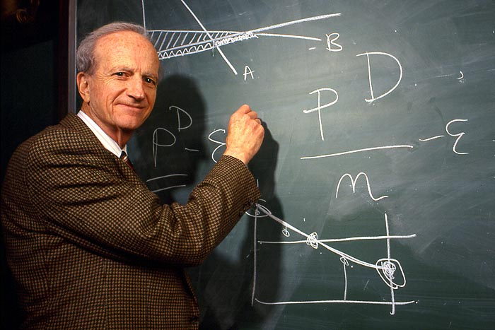
Gary Becker
Gary Stanley Becker
(December 2, 1930 – May 3, 2014):
He won the Nobel Prize in Economics
in 1992.
He was one of the first economists to go into research questions that were traditionally considered topics belonging to sociology, including racial discrimination, crime, family organization, and drug addiction (see Rational addiction).
According to the Beckerian view, many different types of human behavior can be seen as rational and utility maximizing, even altruistic behavior.
What Limits to Using Money Prices to Buy and Sell?

Slide 35
What is you view on this?
Buy and sell human organs (kidneys)?

Slide 36
A case of inefficiency: Government control on prices
A price floor (also known as a minimum price) is a legal minimum on the price of a good or service.
If the government imposes a minimum price in a market, then the buying and selling price of the good cannot be lower than this minimum price.
An example is the minimum wage.
As a result of the minimum price, the quantity supplied exceeds the quantity demanded.

Slide 37
Loss in Efficiency Too High of Price (Price Floor) Ex. Minimum wage
Price
Deadweight Loss
Lost Consumer Surplus
S
New Consumer Surplus
P_{H}
P_{o}
Lost Producer Surplus
New Producer Surplus
D
Q_{L}
Q_{o}
Quantity

